Slide 1
MAY TRAINING SERIES · GROUP SESSION 1 · 16 MAY 2026
Writing a
Concept Paper
Foundations, Framework & First Steps
Presented by Miheso
Session covers: Introduction · Problem Statement · Objectives · Significance

Slide 2
SESSION ROADMAP
What We'll Cover Today
01
02
03
04
Introduction
Problem Statement
Objectives
Significance
What is a concept paper? Purpose, audience & context
Articulating the gap, the need, and the case for research
General & specific objectives — writing them right
Who benefits? Why does this research matter?

Slide 3
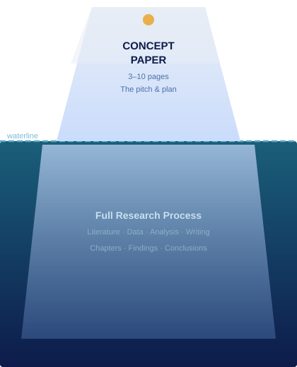
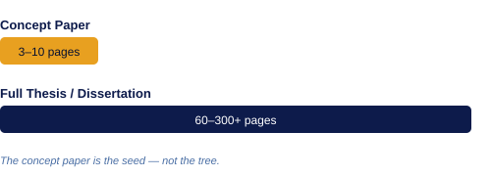
01 · INTRODUCTION
What Is a Concept Paper?
A concept paper is a brief but rigorous document that presents the core idea of a proposed study — its purpose, need, and direction.
Think of it as your research pitch — convince your supervisor the idea is worth pursuing.

Slide 4
01 · INTRODUCTION
Anatomy of a Concept Paper
Introduction / Background
Context of the study; what has happened to bring us here?
Problem Statement
The gap, tension, or unresolved issue demanding research
Research Objectives
General objective + specific objectives (3–5)
Significance of the Study
Value to policy, practice, theory, and the community
Scope & Limitations
Boundaries and constraints (Muli's session)
Literature Review
Existing scholarship and identified gaps (Muli's session)
Methodology
How you will carry out the research (Muli's session)
Miheso's session today

Slide 5
02 · PROBLEM STATEMENT
The Heart of Your Concept Paper
The Broad Context
What is the global/national/sectoral situation?
The Specific Gap
What is missing, unclear, conflicted, or unaddressed?
Your Research Focus
What exactly does THIS study address?
Ask yourself: "What problem exists that has NOT been adequately addressed — and why must it be solved NOW?"

Slide 6
02 · PROBLEM STATEMENT
What Makes a Strong Problem Statement
✓ STRONG PRACTICE
✗ COMMON PITFALL
Backed by data, statistics, or documented evidence
Vague claims like 'there is a problem in Kenya'
Clearly identifies WHO is affected and HOW
Describes background instead of stating a problem
Shows the consequence of NOT solving it
Problem is obvious — no need for research
Ends with a precise research question or statement
Too broad, or too narrow to be meaningful

Slide 7
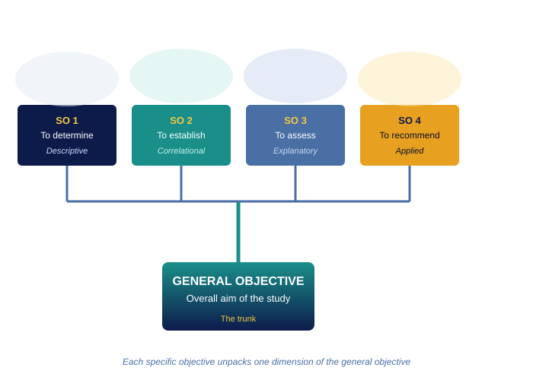
03 · OBJECTIVES
Crafting Research Objectives
GENERAL OBJECTIVE
One broad statement describing the overall aim of the study.
"To examine the influence of X on Y among Z in [place]."
SPECIFIC OBJECTIVES
Each unpacks one dimension of the general objective. Aim for 3–5.
SO1
To determine
SO2
To establish
Descriptive
Correlational
SO3
To assess
SO4
To recommend
Explanatory
Applied

Slide 8
03 · OBJECTIVES
The SMART Test for Objectives
S
Specific
Exactly what will be measured, observed, or examined?
M
Measurable
Can progress and achievement be tracked or quantified?
A
Achievable
Realistic within your resources, time, and access?
R
Relevant
Directly tied to the problem statement and study context?
T
Time-bound
Can it be accomplished within the study's timeframe?
Pro tip: Start each specific objective with an action verb — To determine, To examine, To establish, To assess, To evaluate

Slide 9
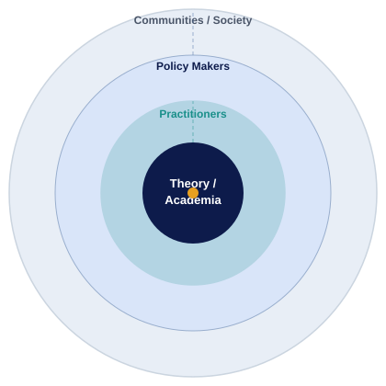
04 · SIGNIFICANCE OF THE STUDY
Why Does This Research Matter?
"Significance answers: So what? Who benefits — and how?"
Theory / Academia
Fills a gap in knowledge; extends or challenges a theoretical framework.
Policy Makers
Informs decisions, regulations, or national strategies.
Practitioners
Offers actionable insights for professionals and field workers.
Communities / Society
Addresses real-world needs of the people or institutions studied.

Slide 10
04 · SIGNIFICANCE OF THE STUDY
How to Write the Significance Section
1
Start from the objectives
Each specific objective should map to at least one beneficiary. If an objective doesn't benefit someone, revisit it.
2
Be specific, not generic
Avoid 'this study will contribute to knowledge.' State who uses it and what decisions they'll make differently.
3
Link back to the problem
Significance = 'If we solve the stated problem, here is what changes for these groups.'
4
Order from macro to micro
Begin with the broadest impact (theory or policy) and narrow to the most direct beneficiary.

Slide 11
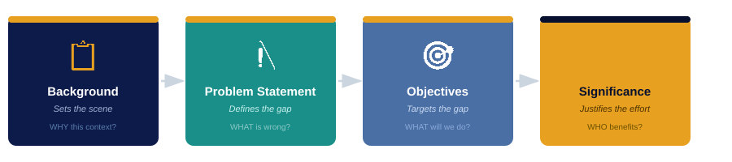
BRINGING IT TOGETHER
The Logic Chain of a Great Concept Paper
The Internal Logic:
Background shows WHY this context demands attention.
Problem Statement shows WHAT is wrong and unresolved.
Objectives show WHAT the study will specifically do about it.
Significance shows WHO will be better off — and why it matters.

Slide 12
SESSION RECAP
Key Takeaways
1
A concept paper is a focused, purposeful pitch — not a mini-dissertation
2
The problem statement is the engine: if it's weak, nothing else works
3
Objectives must be SMART, verb-led, and logically nested
4
Significance is not about you — it's about who else benefits and how
Next up (23 May) — Muli's Session: Scope · Limitations · Literature Review · Methodology
May Training Series · Group Session 1 · Miheso · 16 May 2026

