Slide 1
Concept Paper
Tobit Research Consulting Limited
Conceptual Framework, operationalization and methodology

Slide 2
CONCEPTUAL FRAMEWORK
A Conceptual Framework is a visual or written structure that shows the relationship between variables in your study.
It guides your research by mapping out what you are studying and how the variables connect.
Key Components
Independent Variable (IV)> The variable that causes change.
Dependent Variable (DV)> The outcome or effect being measured.
Moderating/Intervening Variables (sometimes included)> Variables that influence the relationship between IV and DV.
Moderating Variable: This variable changes the strength or direction of the relationship between the IV and DV. It comes from outside the IV-DV relationship and influences how strong the effect is.

Slide 3
CONCEPTUAL FRAMEWORK CONT…
Intervening Variable (also called Mediating Variable)This variable explains the process/mechanism through which the IV affects the DV. It sits in between the IV and DV in the causal chain.
For instance: Effect of Leadership Styles on Employee Performance in Commercial Banks in Kenya: The Moderating/ Intervening effect of Organizational Culture
Moderator: The strength of the relationship between Leadership Styles and Employee Performance depends on the type of Organizational Culture present in the bank.
Simply: Transformational leadership works better in some cultures than others
Mediating/ Intervening: Leadership Styles first shape and change the Organizational Culture, and it is through that culture that employee performance is ultimately affected.
Simply: Leadership creates a certain culture that culture then drives performance

Slide 4
CONCEPTUAL FRAMEWORK CONT…
Intervening Variable (also called Mediating Variable)This variable explains the process/mechanism through which the IV affects the DV. It sits in between the IV and DV in the causal chain.
For instance: Effect of Leadership Styles on Employee Performance in Commercial Banks in Kenya: The Moderating/ Intervening effect of Organizational Culture
Moderator: The strength of the relationship between Leadership Styles and Employee Performance depends on the type of Organizational Culture present in the bank.
Simply: Transformational leadership works better in some cultures than others
Mediating/ Intervening: Leadership Styles first shape and change the Organizational Culture, and it is through that culture that employee performance is ultimately affected.
Simply: Leadership creates a certain culture that culture then drives performance

Slide 5
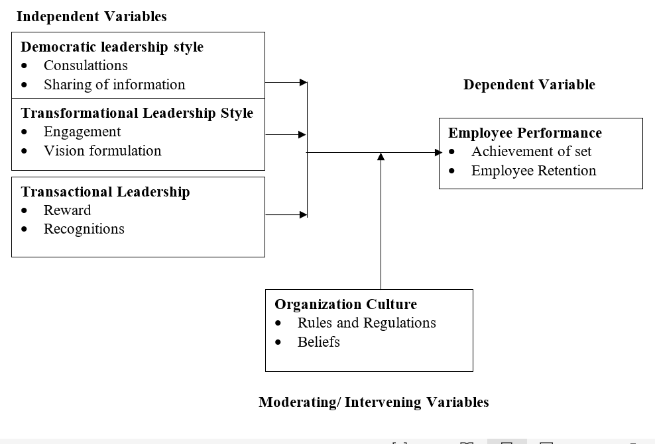
CONCEPTUAL FRAMEWORK CONT…

Slide 6
OPERATIONALIZATION
Operationalization is the process of defining how you will measure each variable in your study using specific, observable and measurable indicators drawn from literature.
Why Literature Review Comes First:
You cannot operationalize what you have not read about.
Literature review helps
Identify how other scholars measured the same variable
Justify your indicators by citing authors
Borrow, adapt or improve on existing measures
Avoid measuring variables blindly without scholarly backing

Slide 7
OPERATIONALIZATION CONT…
Variable | Type | Indicators
Democratic Leadership | IV | Consultations, Sharing of Information
Transformational Leadership | IV | Engagement, Vision Formulation
Transactional Leadership | IV | Rewards, recognitions
Organizational Culture | Moderator | Rules and Regulations, beliefs
Employee Performance | DV | Achievement of Set Targets, Employee Retention

Slide 8
RESEARCH DESIGN
Research design is the overall plan or blueprint that guides a researcher on how to collect, measure and analyze data in a study
It provides the logical structure of the research ensuring that the study addresses the research problem effectively and scientifically
The most common research designs are descriptive, correlational, experimental and exploratory designs
Descriptive research design describes the characteristics or features of a subject, population or phenomenon as they currently exist without manipulating any variables.
Correlational research design seeks to establish the relationship or association between two or more variables without manipulating them.
Experimental research design involves the deliberate manipulation of one variable to observe and measure its effect on another variable in a controlled setting.
Exploratory research design is used to investigate a poorly understood or new phenomenon where little or no previous literature exists in order to gain initial insights.
The choice of research design is determined by the nature of the research problem, objectives, and the type of data needed

Slide 9
TARGET POPULATION
Target population refers to the entire group of individuals, objects or events that share common characteristics and are of interest to the researcher
It is the complete set of people or elements from which the researcher wants to draw conclusions and generalize findings
Defining the target population is important because it sets the boundaries of the study and clarifies who the research findings apply to
A well defined target population ensures that the right respondents are studied making the findings relevant and meaningful
Target population can be finite (countable e.g. employees in a bank) or infinite (uncountable e.g. all social media users)
The rationale for defining target population is to avoid studying everyone which would be costly and time consuming hence the need to identify a specific manageable group

Slide 10
DATA SOURCES
Data sources refer to the origins or places from which a researcher obtains information needed to answer research questions
There are two main types of data sources namely primary data sources and secondary data sources
Primary data is original data collected firsthand by the researcher specifically for the current study through questionnaires, interviews or observation
Secondary data is data that was previously collected by other researchers or organizations for different purposes but is useful for the current study
Data sources are important because they determine the quality, accuracy and relevance of the information used to draw research conclusions
The rationale for identifying appropriate data sources is to ensure that the researcher collects sufficient, credible and valid evidence to support or reject the study hypotheses

Slide 11
DATA SOURCES
Data sources refer to the origins or places from which a researcher obtains information needed to answer research questions
There are two main types of data sources namely primary data sources and secondary data sources
Primary data is original data collected firsthand by the researcher specifically for the current study through questionnaires, interviews or observation
Secondary data is data that was previously collected by other researchers or organizations for different purposes but is useful for the current study
Data sources are important because they determine the quality, accuracy and relevance of the information used to draw research conclusions
The rationale for identifying appropriate data sources is to ensure that the researcher collects sufficient, credible and valid evidence to support or reject the study hypotheses

Slide 12
DATA ANALYSIS
Data analysis is the process of inspecting, cleaning, transforming and modeling data with the goal of discovering useful information and drawing conclusions
It is the stage where raw data is given meaning by applying statistical or qualitative techniques to answer research questions and test hypotheses
Data analysis is important because it converts collected data into findings that can be interpreted, discussed and used to make recommendations
There are two broad approaches to data analysis namely quantitative analysis which uses statistical tools and qualitative analysis which uses thematic or content analysis
Common quantitative analysis techniques include descriptive statistics, correlation, regression, ANOVA and factor analysis each serving a specific analytical purpose
The rationale for choosing an appropriate analysis technique is that different research objectives require different statistical tools and using the wrong tool leads to misleading findings and conclusions

Slide 13

THANKS FOR YOUR KIND ATTENTION !

